Slide 1
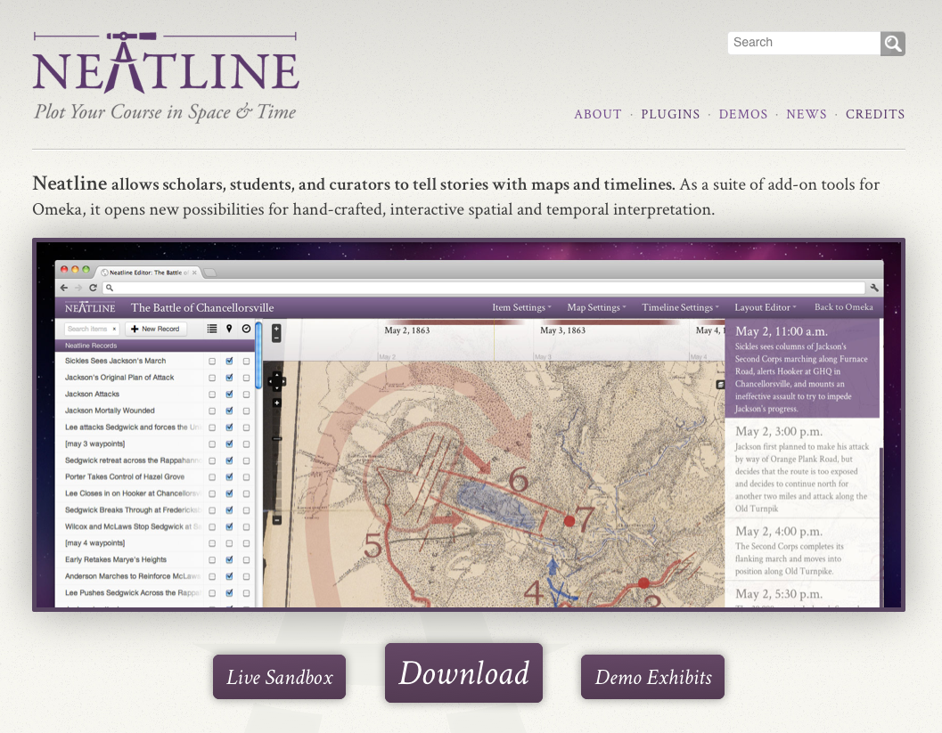
Neatline
Mia Ridge, Open University
Neatline workshop, University of Strathclyde, Glasgow

Slide 2
Outline

Slide 3
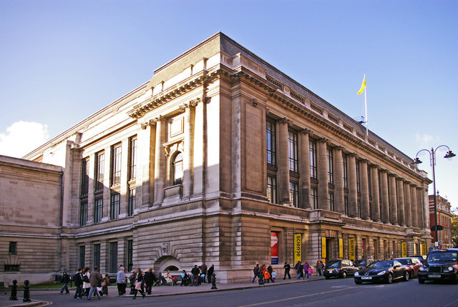
Intros round: who am I?
Geek turned PhD in digital humanities/history
Notes will be at http://miaridge.com
@mia_out
Melbourne Museum photo by Fir0002/Flagstaffotos; Science Museum photo by Christine Matthews

Slide 4
Intros round: who are you?
Your name and background?
One line on what you want to learn today

Slide 5
What is Neatline?
Notes:
http://lovecraft.scholarslab.org/neatline-exhibits/show/lovecraft-in-providence/fullscreen

Slide 6
What is Neatline?
‘My dear little Nellie’
http://hotchkiss.scholarslab.org/neatline-exhibits/show/my-dear-little-nelly/fullscreen
“I am It, and It is I”: Lovecraft in Providence
http://lovecraft.scholarslab.org/neatline-exhibits/show/lovecraft-in-providence/fullscreen

Slide 7
What is Neatline? (the backend view)
Notes:
[In case live demo isn’t possible]

Slide 8
What is Omeka?
Notes:
[In case live demo isn’t possible]

Slide 9
Image source: http://omeka.org/about/

Slide 10
Omeka item
Notes:
[In case live demo isn’t possible]

Slide 11
Omeka item metadata
Notes:
[In case live demo isn’t possible]

Slide 12
Omeka item files
Notes:
[In case live demo isn’t possible]

Slide 13
Neatline Exhibit list
Notes:
[In case live demo isn’t possible]

Slide 14
Neatline Exhibit metadata
Notes:
[In case live demo isn’t possible]

Slide 15
Adding Neatline item
Notes:
In case the live demo doesn’t work!

Slide 16
Exercise: mapping modernist correspondence
Log in with details from email http://www.digitalhistories.org.uk/admin/
Follow steps at http://neatline.org/plugins/neatline/ after ‘To add a new record to the exhibit’ to create a new item in Neatline. Decide whether you want to transcribe or describe the letter; type the text into the description field.
Place it on the timeline and map
Save and view on the public interface

Slide 17
Further exercises
Extend your entry
Enhance your entry

Slide 18
Exercise: extend your entry
Look for other places or journeys in your letter - how might you include them on the map?
Look for other times in your letter? How might you include them on your timeline?
Can you create links to other items? (other correspondence)
Are there references to other entities (people, events, concepts) you might include?

Slide 19
For bonus points: enhance your entry
Try changing the styles of your item, set the map focus or test a point graphic
Try creating an Omeka ‘document’ item and uploading the image of your letter

Slide 20
What did you learn?
What kinds of interpretive decisions did you find yourself making?
What delighted you? What frustrated you?
How might you use it in your work?

Slide 21
Find out more
Basic documentation
http://neatline.org/plugins/neatline/
Neatline demos
http://neatline.org/neatline-in-action/
Georeferencing with Neatline
http://neatline.org/2012/08/20/using-neatline-with-historical-maps-part-1-georeferencing/ (and part 2 and 3)

Slide 22
Thank you! Neatline workshop, University of Strathclyde, Glasgow November 8, 2012
Mia Ridge, Open University
@mia_out
m.ridge@open.ac.uk
Notes at http://miaridge.com

